Slide 1

MiaSeen
LUCY AGAZARYAN
HOVIK MARKOSYAN
TM

Slide 2
“I ALWAYS WONDERED
WHY SOMEBODY DIDN'T
DO SOMETHING
ABOUT THAT
AND THEN I REALIZED
I AM SOMEBODY.”
– LILY TOMLIN

Slide 3
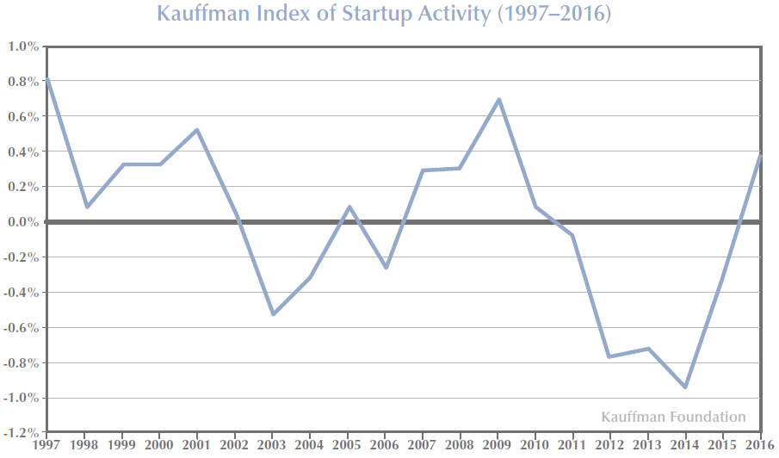
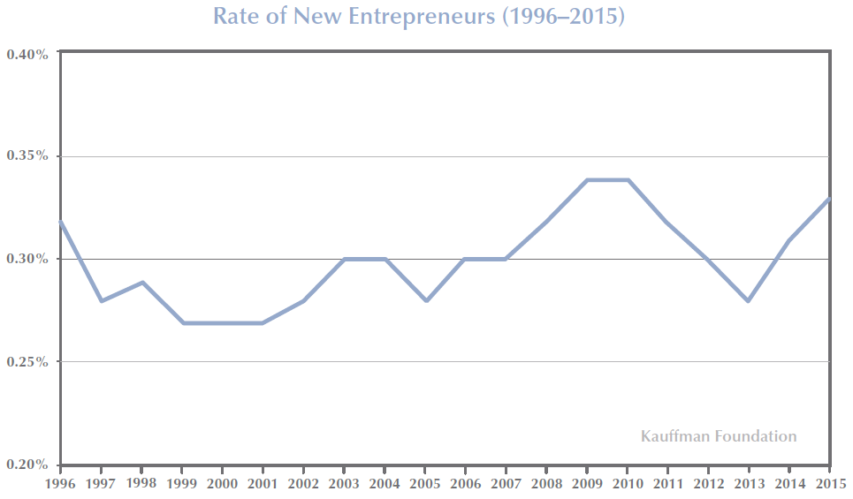
TIME
TO SEIZE
THE OPPORTUNITY
THE RATE OF NEW ENTREPRENEURS MEASURES THE
PERCENTAGE OF THE ADULT, NON-BUSINESS-OWNER POPULATION
THAT STARTS A BUSINESS EACH MONTH.
Source: Kauffman-Index

Slide 4
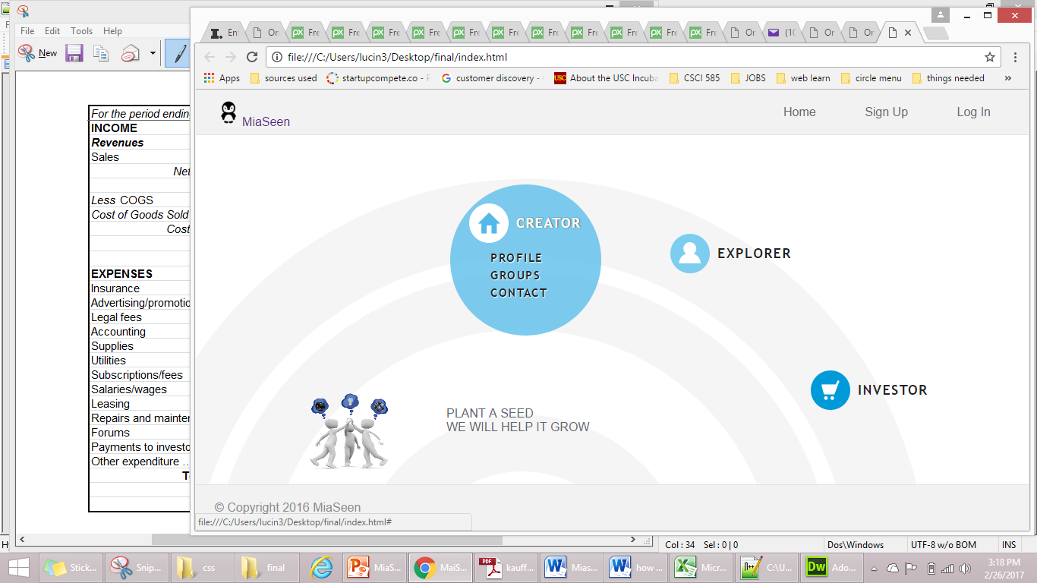
SOLUTION

Slide 5



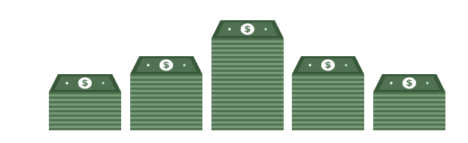
REVENUE MODEL

Slide 6


TARGET MARKET
IDEAL CUSTOMER = ENTREPRENEUR
GENDER
FEMALE
40.6%
MALE
59.4%
Source: Tech-Crunch
Source: Kauffman-Index
Source: Kauffman-Index
Source: Kauffman-Index

Slide 7

COMPETITONS
WORD OF MOUTH
EVENTS
MARKETING
SEO
SOCIAL MEDIA MARKETING
ADVERTISING

Slide 8
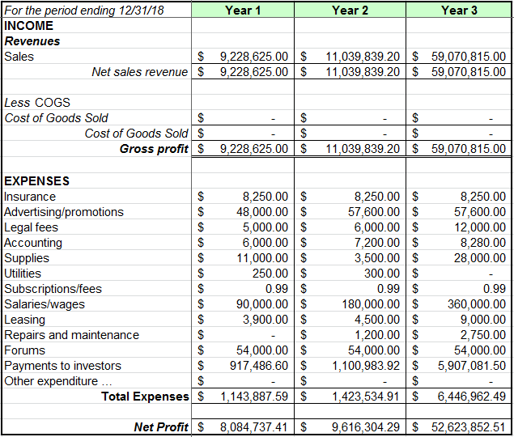
FINANCIALS
Source: IBIS World

Slide 9



COMPARATIVE ADVANTAGE:
ONE-STOP SHOP
MiaSeen
Source: Inc.com

Slide 10

SOCIAL IMPACT
SMALL BUSINESSES ARE THE BACKBONE OF THE ECONOMY
SBA AND MIASEEN

Slide 11



WHAT’S NEXT

Slide 12
MiaSeen
BOARD MEMBERS:
Armine Hartounian - Finance, CalTech
Rouben Krikouryan - Economist, SoCalGas
David Ktshozyan –Attorney, Kaufman Borgeest & Ryan LLP
TM

